Slide 1
Advanced Database Topics
Instructor:
Dr.Stephanos Mavromoustakos
03-60-615-02

Slide 2

Prepared By: - Mitanshi Patel - 104892554
Jagruti Bhudiya - 104908316
Hiral Patel - 104711509

Slide 3
Contents
Introduction
Products of Tableau
Data Visualization
Connecting to Data
Cross-Database Join
Cycle of Visual Analysis
Outcomes of Analysis

Slide 4
Introduction
is one of the fastest evolving business intelligence and data visualization tool. It is very quick to deploy, easy to learn and very spontaneous to use for a customer.

Slide 5
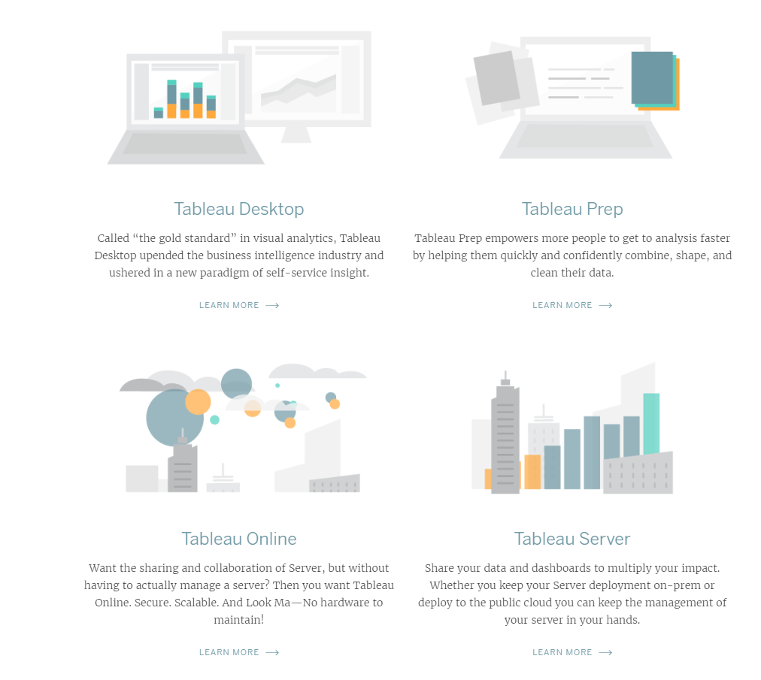
Products of Tableau

Slide 6
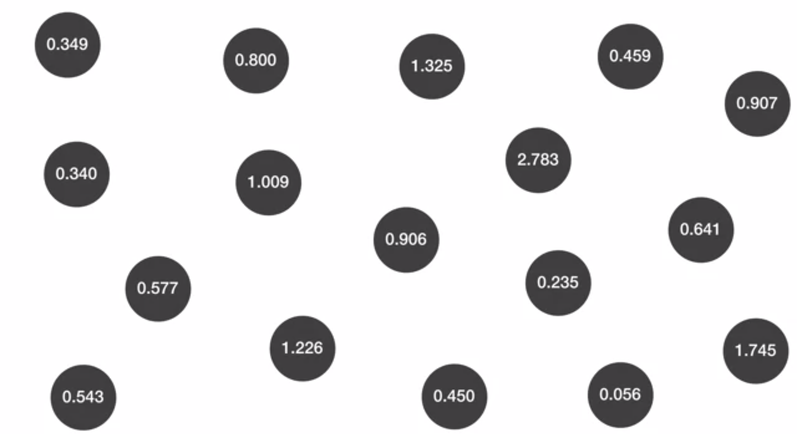

Slide 7
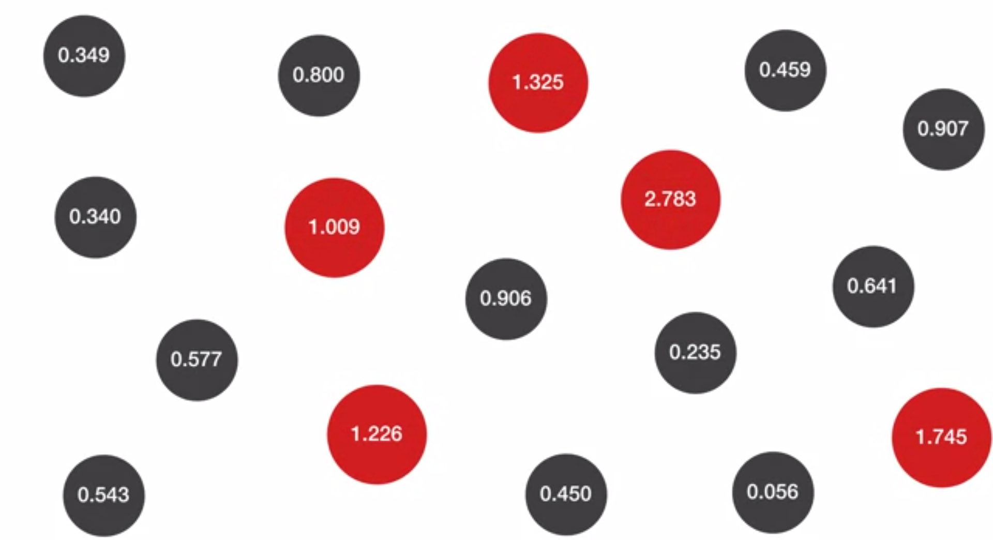

Slide 8
Data Visualization
Data Visualization :- The presentation of data in a pictorial or graphical format.
Power of data visualization
Predict the future.
Communicate concepts.
Relevance in millions of variables.

Slide 9
Let’s connect Tableau to the data!
Connecting to data
Excel Database Cloud

Slide 10
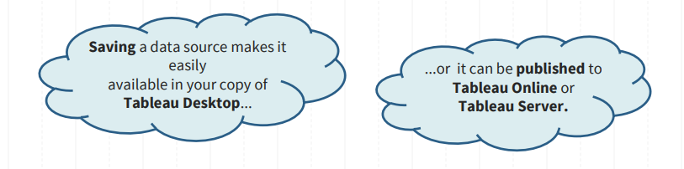
Saving and Publishing Data Sources
Saving data source as a .tds -> this is not the data itself!

Slide 11
Total File Types
Workbook (.twb): Workbooks hold worksheets, dashboards and stories.
Bookmark (.tbm): Bookmarks contain a single sheet.
Packaged workbook (.twbx): Archive containing a workbook along with all data sources and files.
Data extract (.tde): Local copy of a subset or entire data source to share and improve the performance.
Data source(.tds): Shortcut to oftenly used data sources, containing information and modifications.
Packaged data source (.tdsx): Archive containing a data source file along with any related files.

Slide 12
Cross-database Join
You can't always answer your questions with a single data set. Sometimes, to answer your hardest questions, you have to integrate multiple data sets to uncover insight.
This is a new feature in Tableau 10

Slide 13
Data Joining And Data Blending
When to use joining:
You can only use joining when your data comes form the same underlying source (for example, the same Excel file or Access file).
When to use data blending:
Data Blending in tableau allows combining of data from different sources and platforms.
For Example, you can blend data present in an flat file (csv) with Teradata or DB2 databases DB to create a combined / blended dataset.

Slide 14
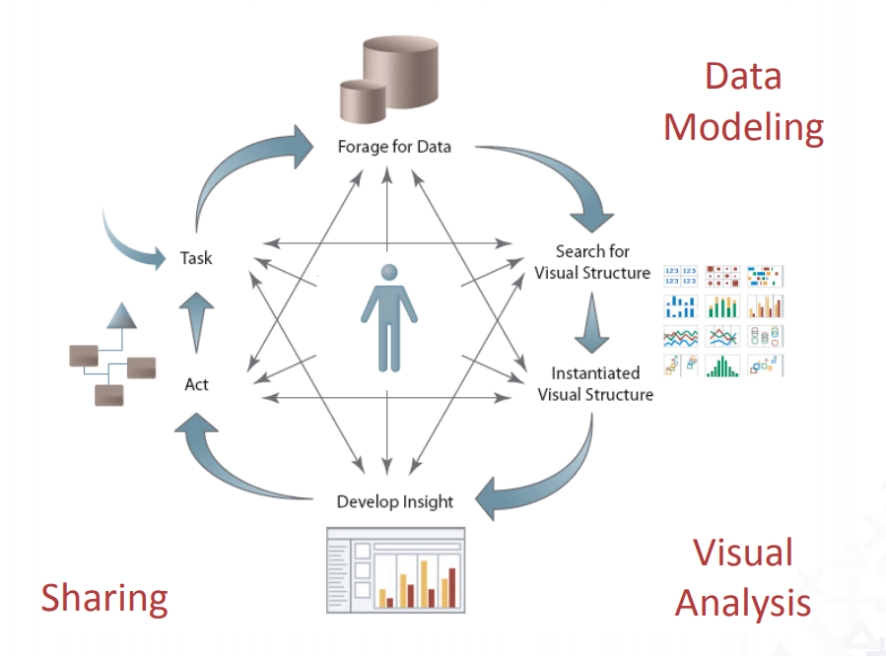
Cycle Of Visual Analysis
An unpredictable and cyclical process of question-and-answer involving many tasks:
• Discovering structure
• Finding patterns and outliers
• Deriving causal relationships
• etc.

Slide 15
Let’s see how Tableau works….
https://eu-west-1a.online.tableau.com/t/

Slide 16
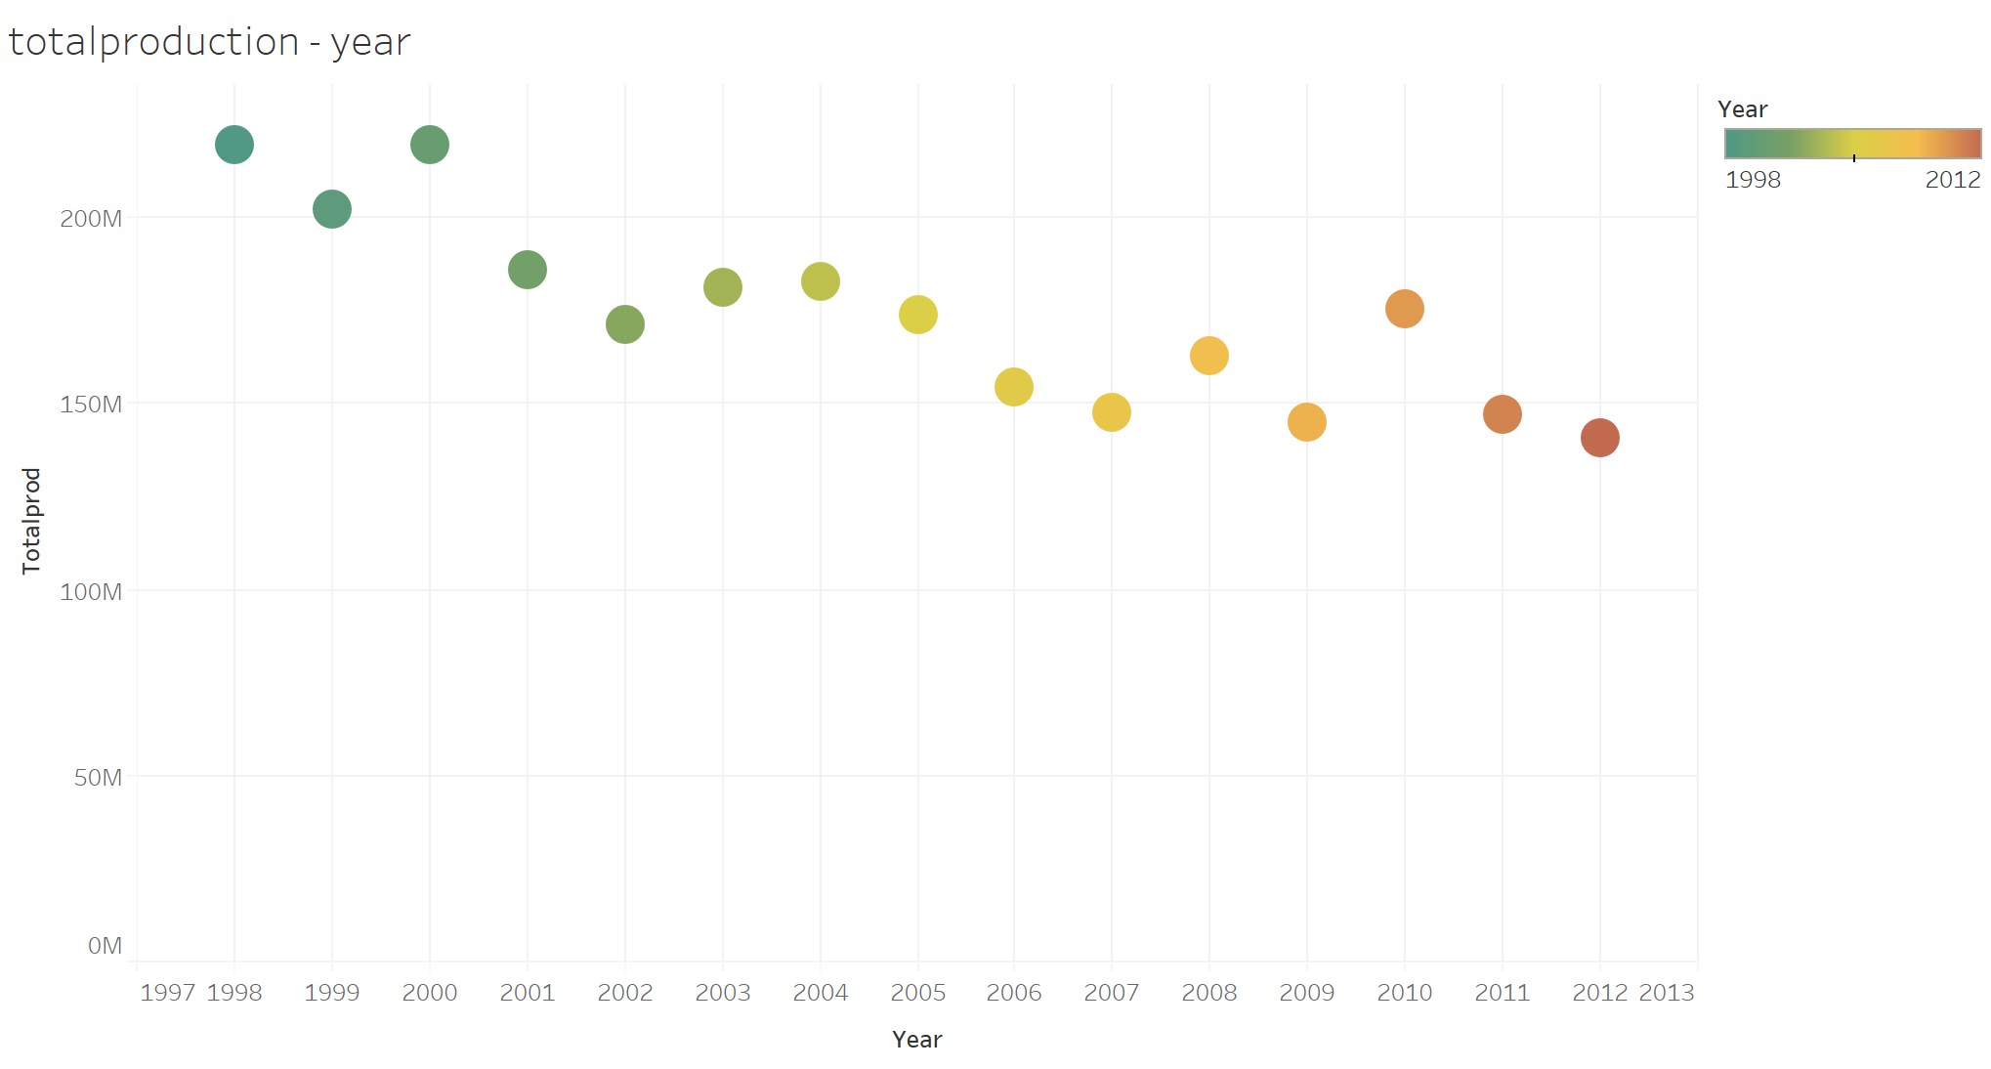

Slide 17
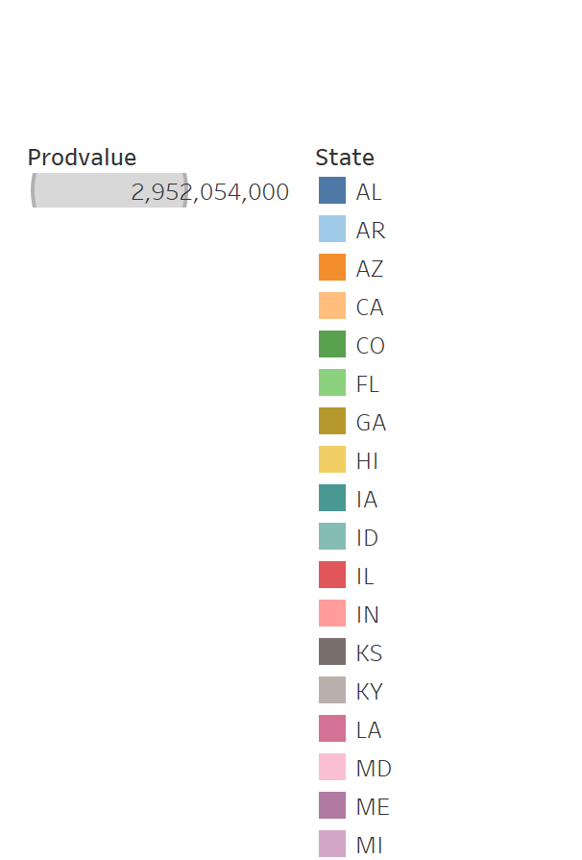
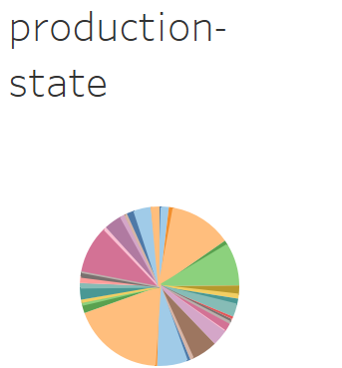
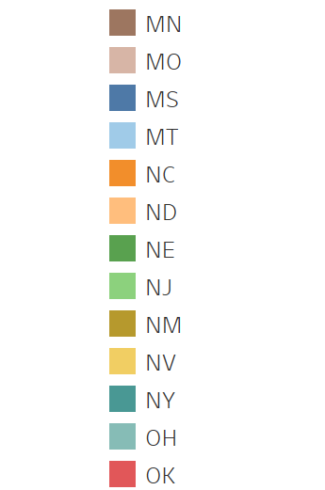
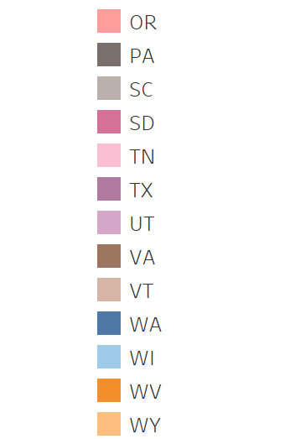

Slide 18
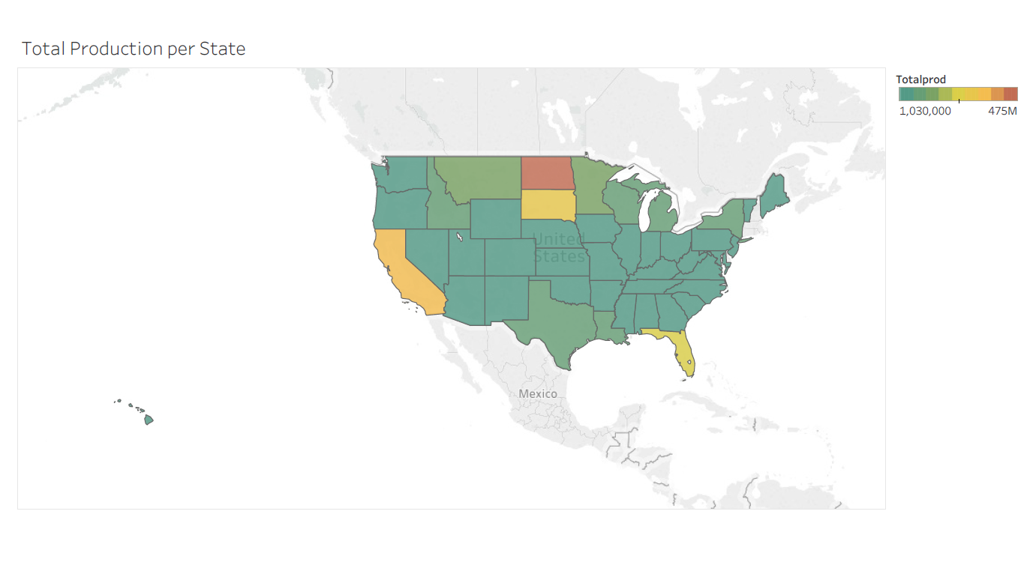

Slide 19
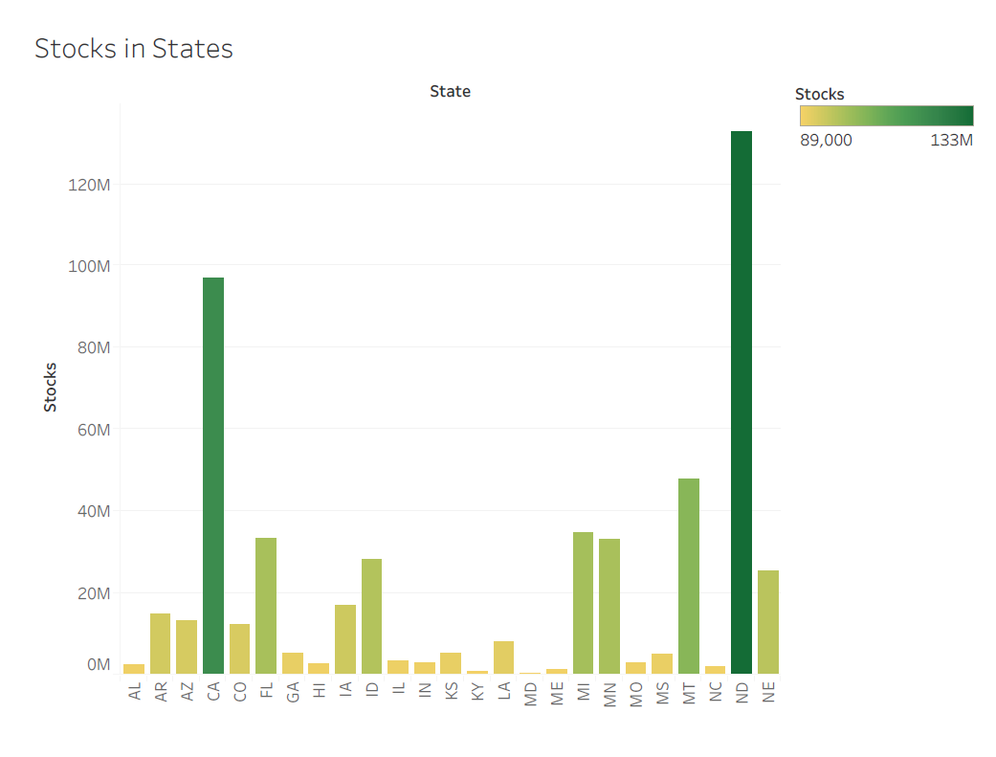

Slide 20
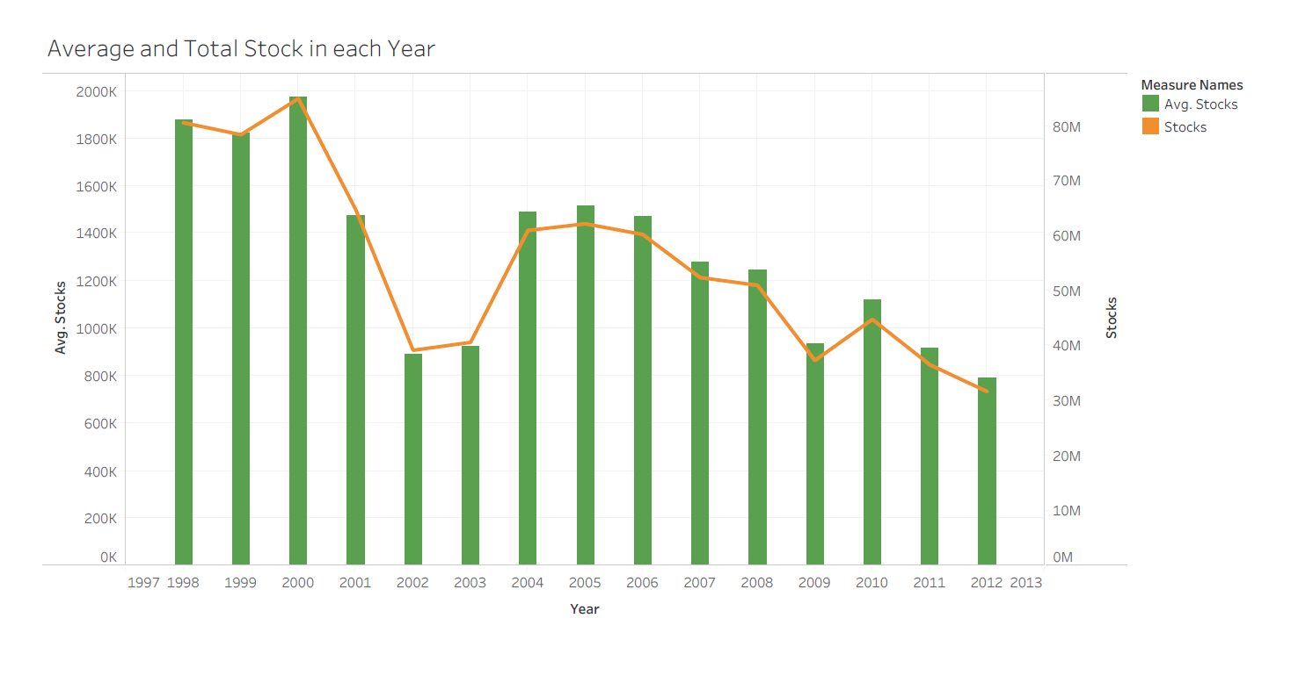

Slide 21
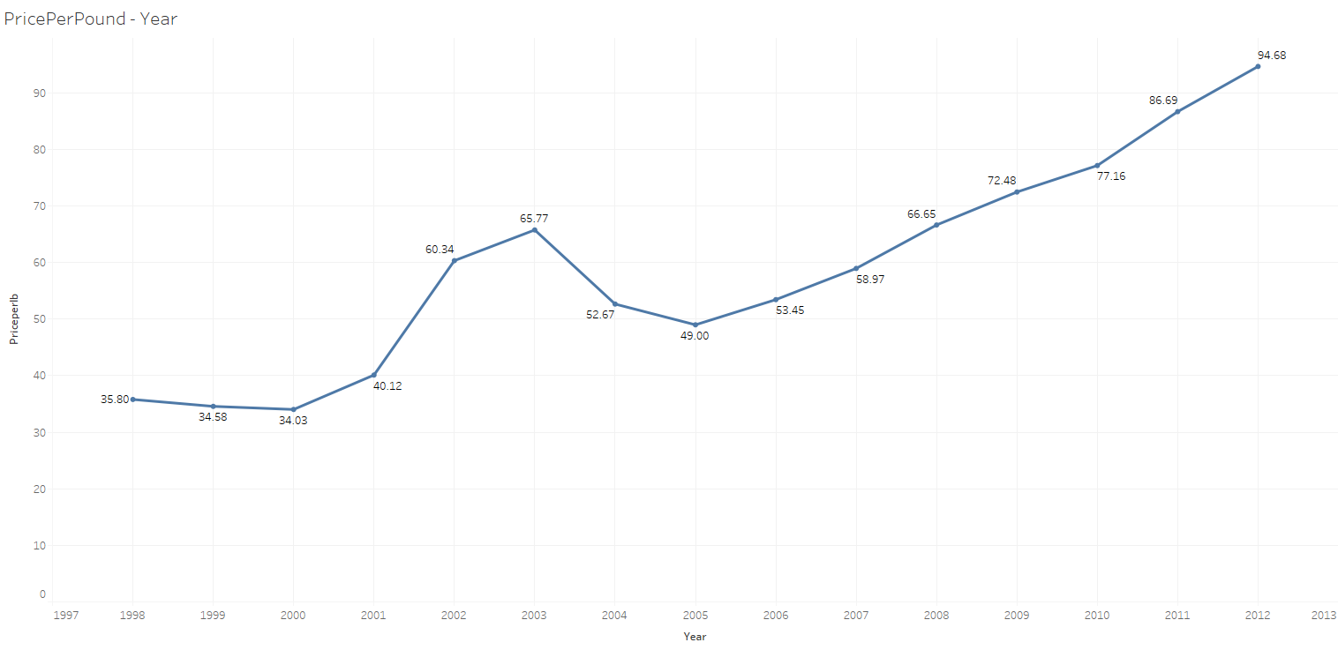

Slide 22
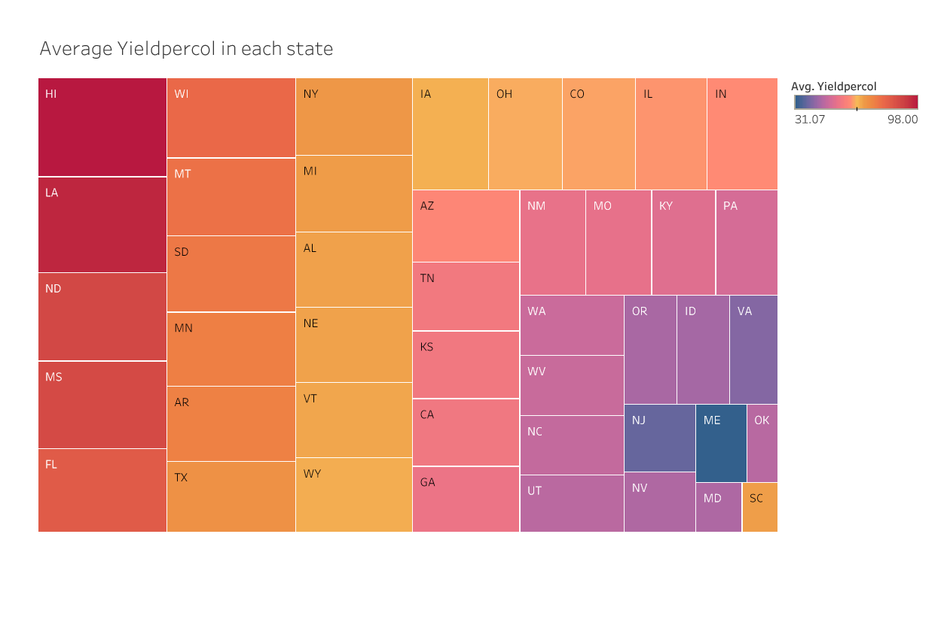

Slide 23
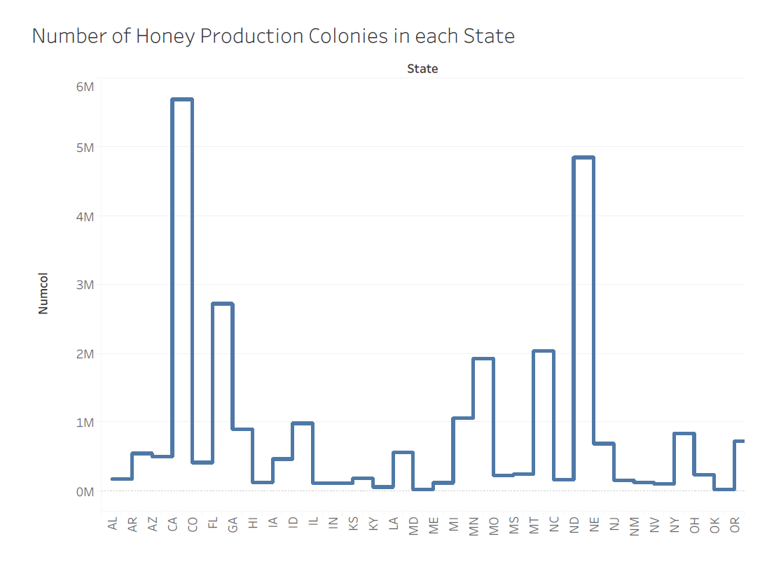

Slide 24
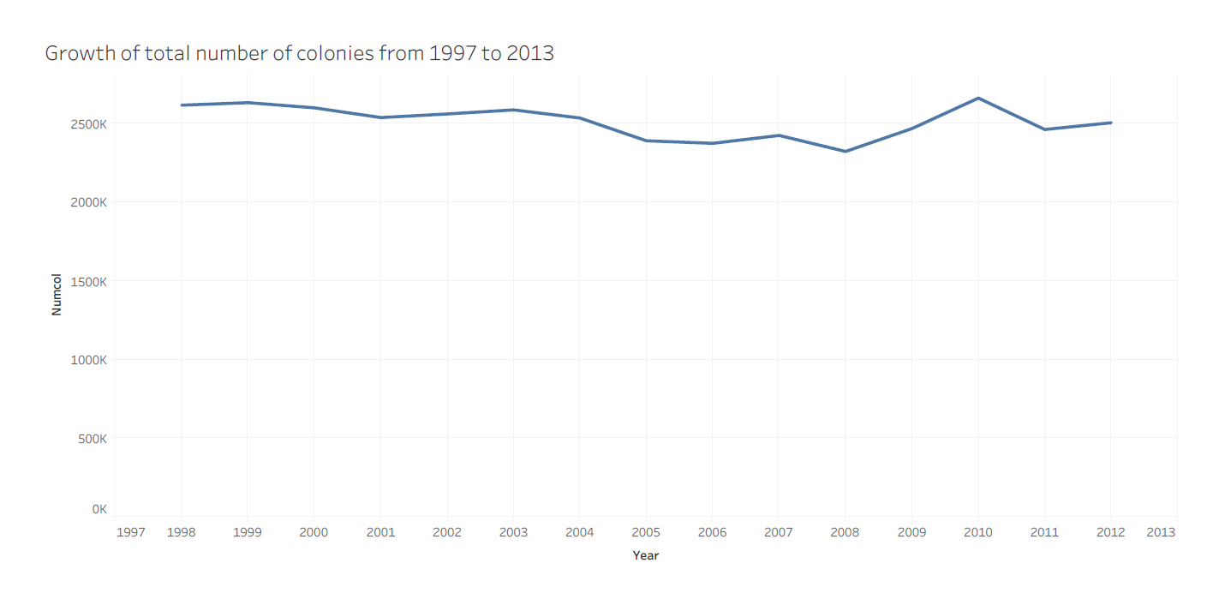

Slide 25
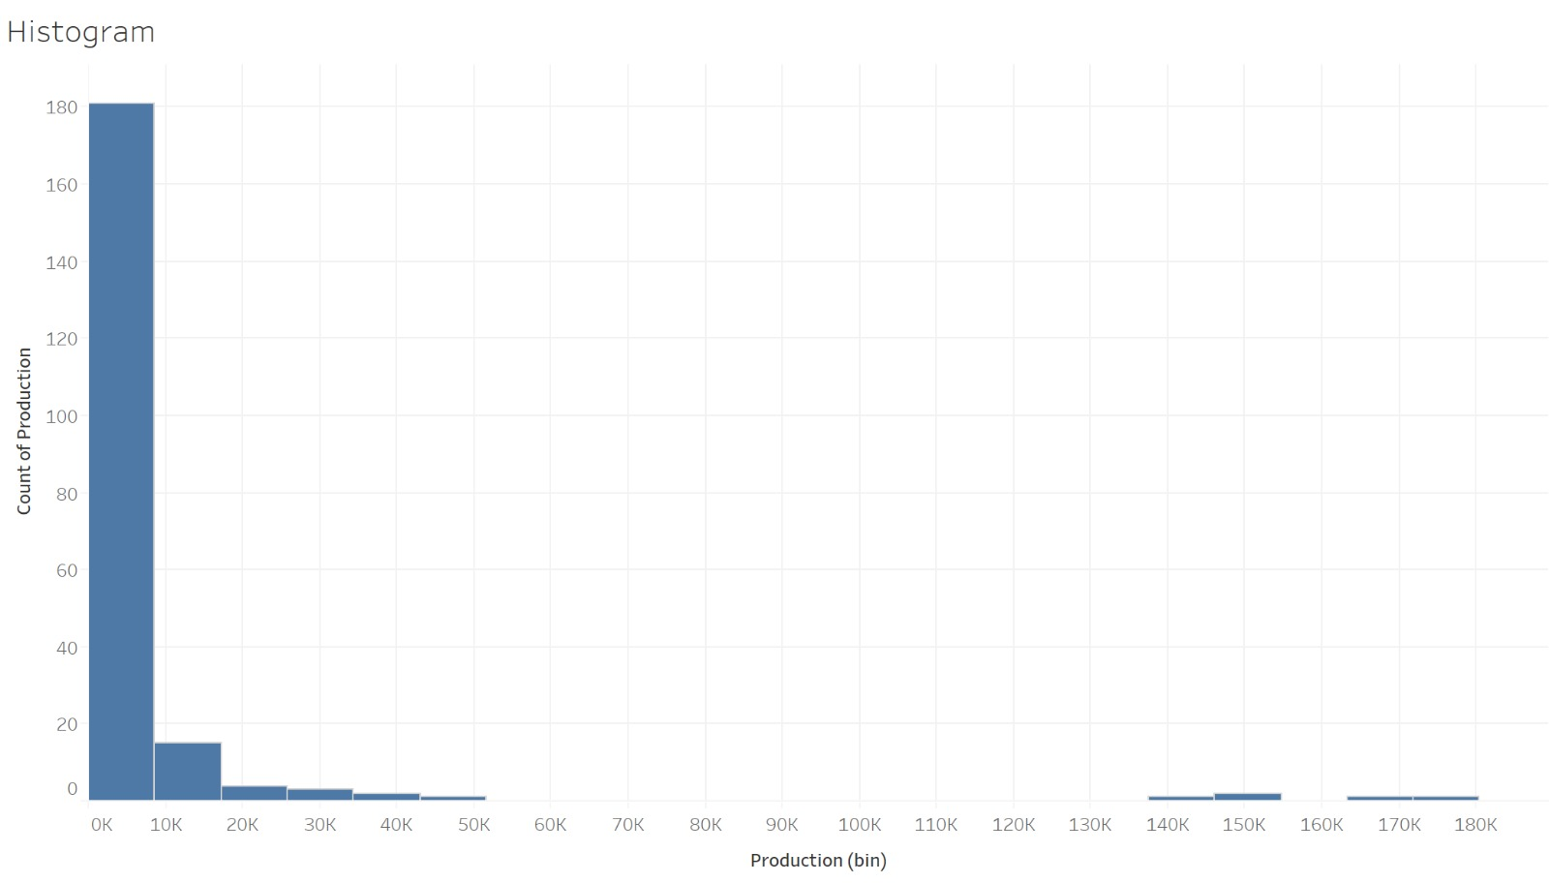

Slide 26
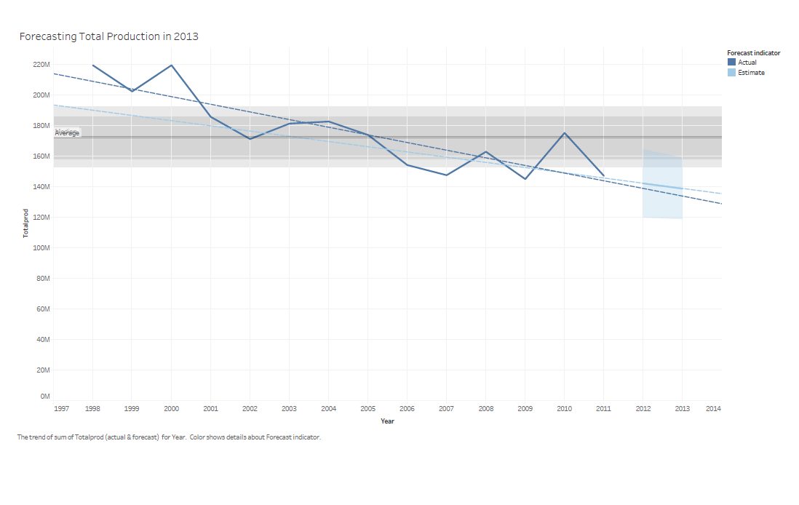

Slide 27
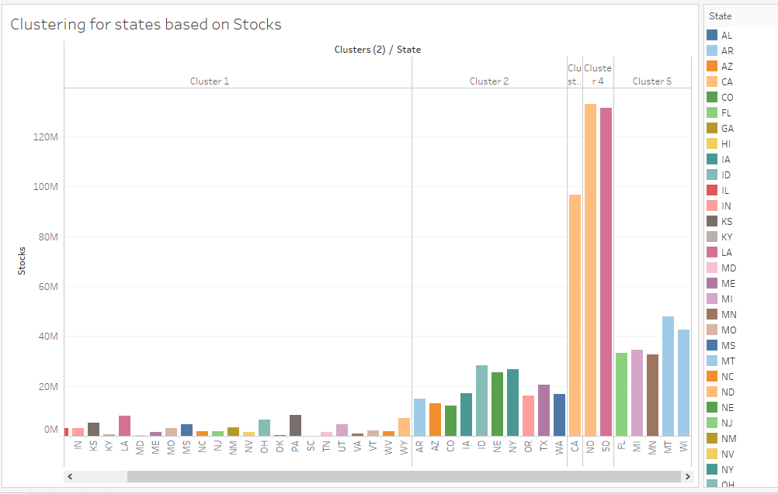

Slide 28
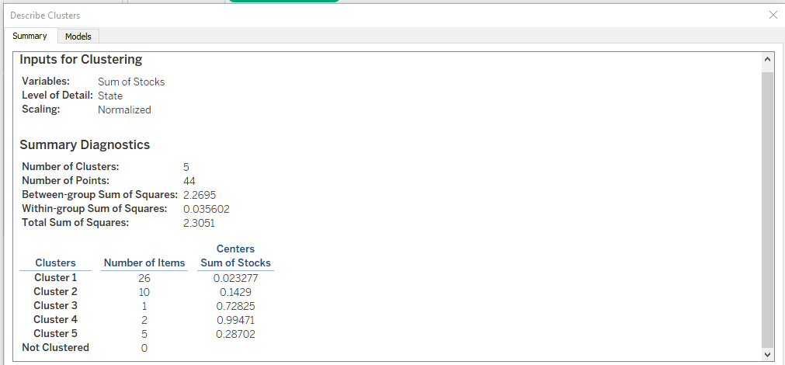

Slide 29
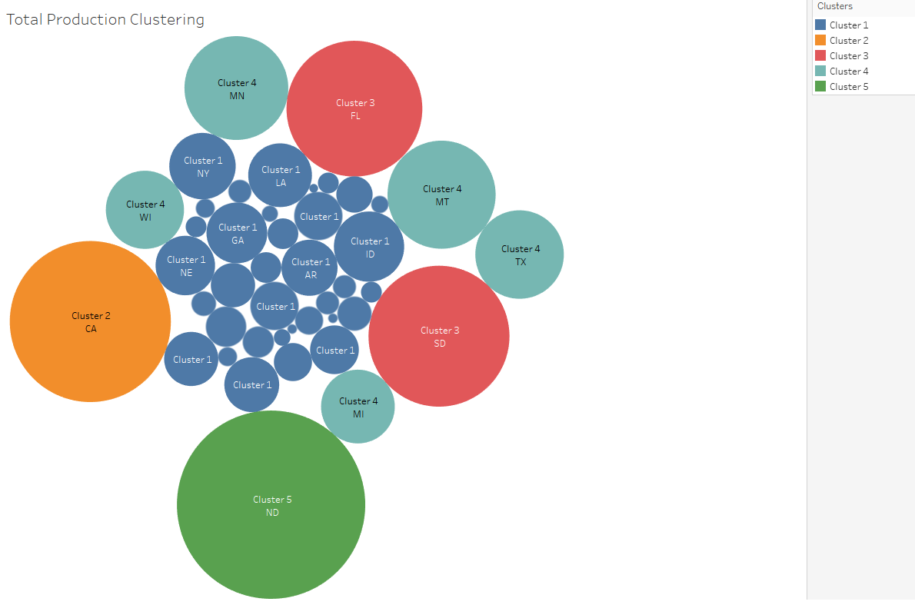

Slide 30
Features of Tableau Online
◉ Skip hardware cost & setup time
◉ Connection with other users
◉ Support live data connections
◉ Secure

Slide 31
References
https://www.tableau.com/products
https://www.slideshare.net/AndreaBissoli/tableau-presentation-70031000?from_action=save
https://www.slideshare.net/seethaBTS/tableau-ppt
https://www.tableau.com/about/blog/2016/7/integrate-your-data-cross-database-joins-56724
https://community.tableau.com/thread/195684
https://ca.images.search.yahoo.com/search/images

Slide 32


